Slide 1

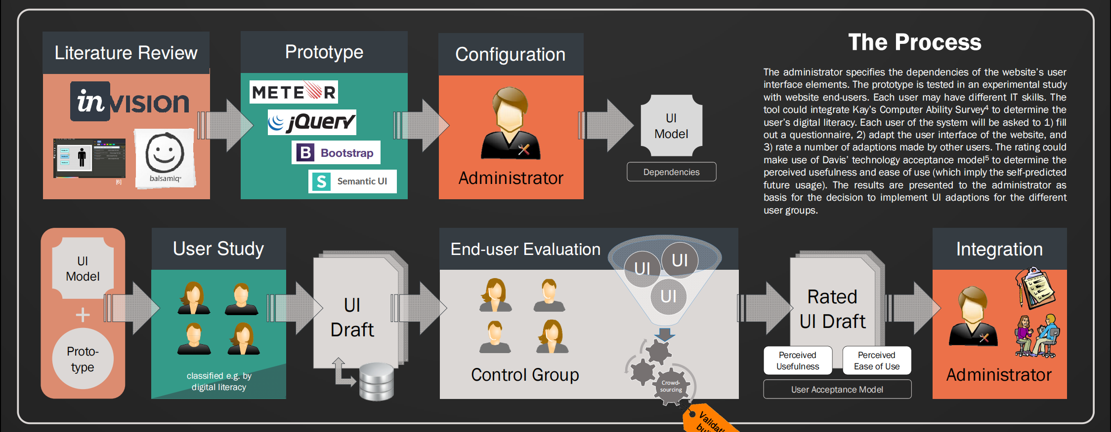
















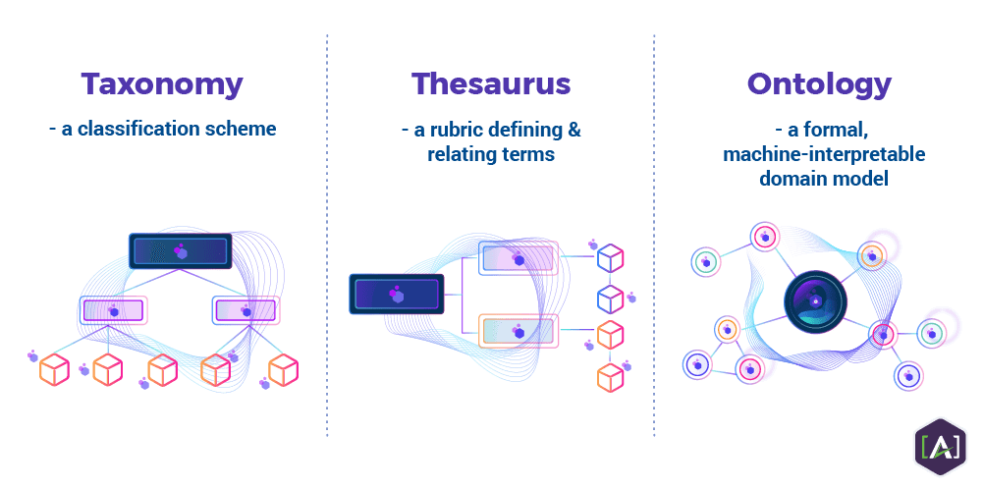











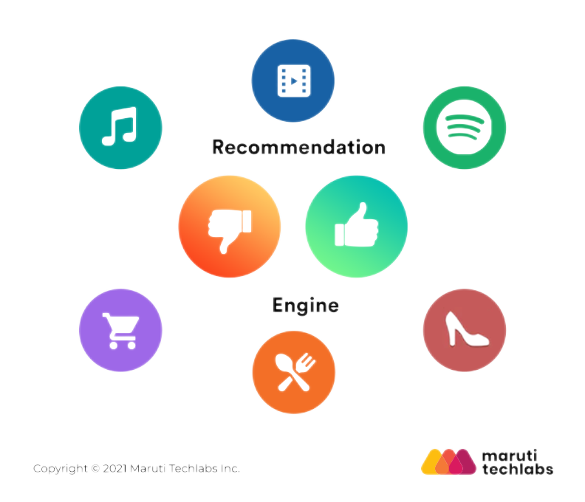










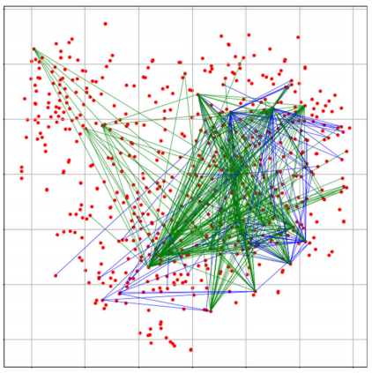
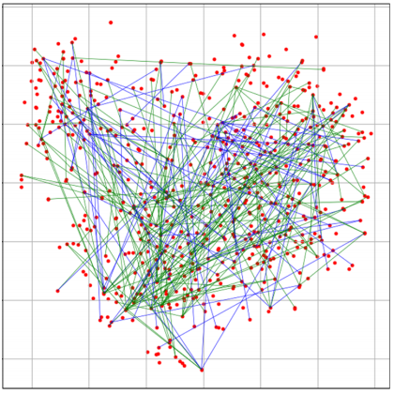

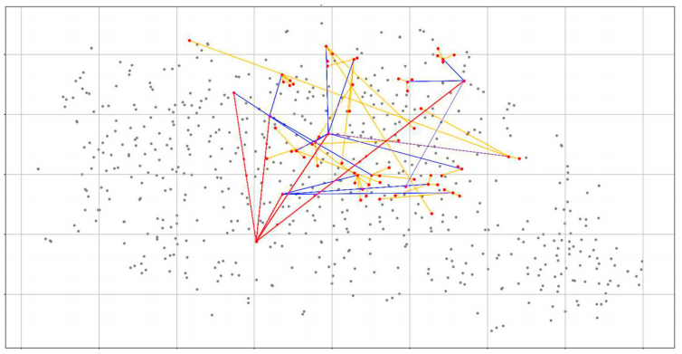



Content-Based Cold Starts in Recommendation System
Author: Ziyi Guo (MSc Data Science) Supervisor: Dr Nicolas Green
School of Electronics and
Computer Science
Background
Recommendation systems aim to identify the most relevant items from a collection to fulfil a user’s search intent. By using known information about the user and items, including interaction data, content data, or both, recommendation systems are producing personalised results without requiring a query, which means the user can receive recommendations with no direct involvement.
interaction histories as new items are recommended based purely on content similarity, but the past interaction records of users are still required for comparison.
In the real-life case of recommendation system, how-ever, there is no behaviour record for the new users, which illustrates the problem of cold start scenarios. The problem is commonly divi-
Collaborative recommender systems
aggregate user interactions to find si-
milar users and recommend the item
they liked. Common techniques in-
clude collaborative filtering, reduc-
ing the dimensionality of the sparse
user-interaction matrix based on a
user’s past interactions. However,
time-sensitive items record may
not remain valid long enough; also
it may result in positive feedback
loops.
Content-based recommendation
systems recommend items based on
similarity to content information
on items. Usually a representation
for a target user is generated based
on item description embeddings.
Content-based systems are less de-
pendent on items with extensive
COLLABORATIVE FILTERING
CONTENT-BASED FILTERING
WHAT IF A COLD START ?
ed into item-wise (new item) and user-wise (new user) cold starts, which are main-ly addressed by content-based and hybrid recom-mendation systems and can be hard relying largely on knowledge bases and onto-logies, or tags and catego-risations.
Due to the high barrier to entry recommendation sys-tem, researchers study time sensitive cases and propose high performance techniqu-es pairing labelled and un-labelled items based on the similarity of their contents, which can be generalised to cold-start problems.
Action Genres
Read by both users (Commom Interests)
Read by user
Similar Users
Comedy Genres
New User
(Target)
Similar Articles
Unknown Rules
Potential Items
(to be recommended)
Read by her, and recommended to him!
Recommended to user
New Item
(Object)
Potential Users
( recommendation targets)
Project Aims & Process
Literature Review
& Data Retrieval
Data Processing
& Visualization
Theorical Semantic Model Proposal
Facing the large labelled data requirement of most existing recommendation tech-niques, techniques that function well with few labels are highly desirable, as ob-taining well labelled data is actually problematic. In this project, based on initial investigations on data labelling problems and the limitations of existing recommen-dation systems, considerable work is scheduled to explore new techniques for pro-viding personalised recommendations for new users in highly chanllenging data-sets where few labels are available for most items, and no labels for new users.
Based on user and item information in the form of natural language descriptive text to expand the sparse relationship distribution, the project
intends to address both user-wise and item-wise cold starts.
Semantic
Modelling
Source Data
System Perspective Task
Ready for Application
Initial Evaluation
Evaluation
& Comment
User-wise Cold Start
Scenario Illustration
& Task Definition
Model Embeddings
& Data Integration
F1 Score & Error in Model Application
Item-wise Cold Start
Recommendation System
Upstream
Embedding
Model
Content-based Correlations in Textual Dataset
Data Perspective Task
Recommendation Score Distribution
Subset Labelled Data
Content-based Semantic Model
Model Performances on Mutli-task
Extremly Sparse-labelled Data
Target Dataset
Semantic
Model
All in all, the project schedules the following workflow:
study current recommendation systems and extremely sparse data labelling problem
process practical data visualization on to representative datasets to explore the data structures and features
propose several semantic models to redefine content-based correlations of textual data
Furthermore,based on the proposed semantic models:
carry out pre-experiment on subset of data to check the availability of the models as the initial evaluation
apply the semantic model to the dataset
make use of current linguistic encoders as upstream embedding model and test a number of them
evaluate performance in various tasks and systems.
Feasibility Discussion & Conclusion
According to the initial study on the ISWC dataset, researchers work out the data structure and draws the text-label reflection (data correlation path) in different tasks.
Further, on applying a proposed Transitive Semantic Relation-ships (TSR) model, researchers show the retreival routes for any possible query in potential recommendation engines. Certainly, the TSR model is tested
on recommendation sys-
tem cold starts tasks and
achieves considerable
results on both accuracy
scores and programing
interpretability.
In spite of the achievements and the feasibility that past researches have provided, there still remains problems to
be solved, which is the start point and expected outcome
of the project:
Tasks concerning multi-user scenario can be expressed as multi-class classification because of the multi-layer structure of users network, which is more general in recommendation systems, and yet to be discussed.
Content-based recognition of similar nodes and target nodes, can be wide in approach (eg. Clustering), and need to be applied to improve performance.
The choice of upstream embedding models influence the performance of proposed semantic models, and is thus worth abundant experiment.
In conclusion, starting with IWSC dataset and TSR model, this project will go on to other databases for new data-sets, study the provenance and structure of
data, propose new content-based sem-
antic model and carry out sufficient
evaluation, making attempts to pro-
vide considerable suggestions for cold starts problem in recommendation systems.
Subset Labelled
Sparsely Labelled
Before this project proposal came out, related work has been proposed on the case of supply chain on the
Isle of Wight, based on the Isle of Wight Su-
pply Chain (IWSC) dataset, which consists
of varying length text descriptions of 630
companies on the Isle of Wight taken via
web scraping from the websites, contain-
ing general textual descriptions of enter-
prises’ market role, activities and products, etc.
Web Data
TSR Retreival Routes
References
Musto, C., Semeraro, G., de Gemmis, M., Lops, P. (2016). Learning Word Embeddings from Wikipedia for Content-Based Recommender Systems. In: , et al. Advances in Information Retrieval. ECIR 2016. Lecture Notes in Computer Science(), vol 9626. Springer, Cham. https://doi.org/10.1007/978-3-319-30671-1_60
https://www.navisite.com/blog/open-source-vs-commercial-database-systems/
https://news.cision.com/agr-dynamics
https://www.iqvia.com/?utm_medium=cpc&utm_source=google&utm_campaign=2021_NextBestGoogleAds_GBU_TCS_MA&utm_content=126031534540&utm_term=content%20based%20recommender
https://www.excentos.com/de/
Ralph, D., Li, Y., Wills, G. et al. Recommendations from cold starts in big data. Computing 102, 1323–1344 (2020). https://doi.org/10.1007/s00607-020-00792-y
Fuzheng Zhang, et al. 2016. Collaborative Knowledge Base Embedding for Recommender Systems. In Proceedings of the 22nd ACM SIGKDD International Conference on Knowledge Discovery and Data Mining (KDD '16). Association for Computing Machinery, New York, NY, USA, 353–362. DOI:https://doi.org/10.1145/2939672.2939673
J. Yuan, W. Shalaby, M. Korayem, D. Lin, K. AlJadda and J. Luo, "Solving cold-start problem in large-scale recommendation engines: A deep learning approach," 2016 IEEE International Conference on Big Data (Big Data), 2016, pp. 1901-1910, doi: 10.1109/BigData.2016.7840810.

